Slide 1

Muhammad Abiodun SULAIMAN
2022/2023 England Premier League Data Visualization

Slide 2

PROJECT OVERVIEW
The task involves writing an automation script which fetches at least 7 days historical records of matches played.
Some of the data points expected from the fetched data include:
Match Played.
Full Time/Half Time score.
Goals Scored and Time.
Scorer/Assister.
Match Statistics

Slide 3

BREAKDOWN OF PROCESSES INVOLVED IN THE PROJECT.
The automation script used for this task was written with the Python programming language. The script makes use of ‘selenium web driver and beautiful soup’ to communicate with the website used (FlashScore). Some of the challenges encountered in the scraping task includes:
Inability to fetch data league by league due to the structure of the website used. The div and class tags of leagues is unconnected to the match details, hence, making it difficult to fetch a comprehensive data which will capture leagues and full match details. Hence, I had to make do with premier league data alone (for data quality and consistency's sake).

Slide 4
CONT’D
Extracting the events details from both the home teams and away teams was not so easy as well, as the data structure came as a nested list. Hence, I had to do some data wrangling which involves first creating separate dataframes off the original dataframe, transforming the extracted dataframes, creating additional features (columns) to hold specific events from each match, unpivoting the events columns such that the columns are converted into two columns; one containing the event header, and the other containing the details of the event. Thereafter, the extracted dataframes were merged on the original dataframe to make the data more easier to work with, and as well enforce data integrity.

Slide 5

CONT’D
The final dataframe was thereafter converted in a CSV file which was used for the Power BI report embedded in this document. Before the final importation into the Power BI Desktop app, the converted data was exported into Microsoft Excel, for review and cleaning before finally working on the Power BI report.
Upon the exportation into Microsoft Excel, it was discovered that some values in both the First Half Score and Second Half Score columns appeared as dates, hence, these values were taken care of, and were converted to the required format (also as a way of ensuring data quality and integrity). The data was finally imported in the Microsoft Power BI Desktop app, some data transformation were done, and the data was ready to be used for the report.

Slide 6

INSIGHTS FROM THE POWER BI REPORT.
From the report, the following insights were derived:
A total of 20 home teams, and 19 away teams have played against each other so far.
A total of 156 goals has been scored.
On the average, ‘Away Team’ tend to have more ball possession than the ‘Home Team’.
On the average, ‘Home Teams’ have had more records of fouls, yellow cards, blocked shoots, offsides, goal attempts, and total passes as compared to the ‘Away Teams’, while the ‘Away Teams’ have had more tackles and throw-ins.
On the average, both the ‘Home Teams’ and ‘Away Teams’ have had equal chances of free kicks, shots on targets, and shot off goals respectively.

Slide 7

Power BI Report
The published Power BI report has been embedded in this presentation for easy access. A filter has been added to the left side of the report, to allow for easy filtering and drill-down on events and statistics for each match. To see what has happened in a specific match, simply select the match from the filter, and you are able to see the match statistics. Similarly, a goal table which contains the minute, scorer, and number of goals scored was attached to the right side of the table to as well make it easy to identify the scorers, and the time the goals were scores.
The published version of the embedded report can be found here

Slide 8

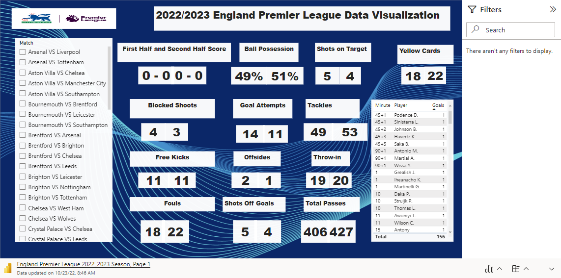
Microsoft Power BI

